Slide 1
Conference Presentation
(Paper ID : 3015)
Paper title :
Image classification of ischemic stroke blood clot origin using stacked EfficientNet-B0, VGG19 and ResNet-152
Authors:
Masabathula V S Raghavendra Rao (Primary Author and Presenter)
Surya Puligundla
Nikhil Sai Ekkala
Srilatha Chebrolu

Slide 2
Agenda
The goal of this work is to classify and differentiate between the two major acute ischemic stroke (AIS) etiology subtypes : cardiac (CE) and large artery atherosclerosis (LAA), using whole slide digital pathology images (WSI).

Slide 3
Definitions
Whole Slide Image (WSI) : A high-resolution digital image of an entire microscope slide, created using a whole slide scanner. These images are widely used in digital pathology, medical imaging, and AI-based diagnostics.
Acute Ischemic Stroke (AIS) : Is a condition when blood flow to a part of the brain is suddenly blocked, leading to a lack of oxygen and nutrients in brain tissue. If not treated quickly, brain cells begin to die, causing permanent damage or disability.
(acute - sudden, ischemic - lack of blood supply)
Etiology : Refers to the cause or origin of a disease or condition.
Cardioembolic (CE) : A cardioembolic stroke occurs when a blood clot (embolus) forms in the heart and travels to the brain, blocking a cerebral artery. This type of stroke is often severe and has a high risk of recurrence.
Large Artery atherosclerosis (LAA) : A large artery atherosclerotic stroke occurs when a major brain-supplying artery (like the carotid or vertebral arteries) becomes narrowed or blocked due to plaque buildup.
H & E staining : A popular staining method that is used to create contrast, making different cellular structures easily distinguishable under a microscope.
Hematoxylin – Stains cell nuclei blue or purple (binds to acidic components like DNA & RNA).
Eosin – Stains cytoplasm, proteins, and extracellular components pink to red (binds to basic components like proteins).

Slide 4
Why
Ischemic stroke remains to be second-leading cause of death after ischemic heart disease.
A second stroke (23% of total events are recurrent) worsens the chances of the patient’s survival. However, subsequent strokes may be mitigated if physicians can determine stroke etiology, which influences the therapeutic management following stroke events.
This work helps physicians better understand the causes of blood clots in fatal strokes, making it simpler for doctors to recommend the most effective post-stroke therapeutic management and lowering the risk of a second stroke.
Eliminates error prone human intervention as the contents of the blood are to be analysed at microscopic level.

Slide 5
How
When a patient experiences an AIS caused by a blood clot blocking an artery to brain, it is removed through mechanical thrombectomy (endovascular procedure).
This clot is stained and preserved as WSIs for further pathological and histological analysis.
Once the WSIs are generated, they undergo preprocessing, and deep learning models extract features to enable classification.
Experiments have been conducted by Mayo Clinic organization and the WSI are preserved.

Slide 6
Methodology

Slide 7
Data Preprocessing
Dataset : “Mayo Clinic - Strip AI” dataset from Kaggle.
Contains 754 high resolution WSI(.tiff)
547 images belong to class CE
207 images belong to class LAA.
Data Preprocessing :
Tiling : Each Whole Slide Image (WSI) is divided into smaller square tiles of 512 × 512 pixels. This ensures that relevant features are more visible and interpretable, avoiding the challenges posed by extremely high or low resolutions.
Filtering : Tiles that contain excessive white background, dark patches, or blurry content are removed. This prevents irrelevant or low-quality data from negatively impacting the deep learning model's training.
Color Normalization : Due to variations in staining protocols across different laboratories, the intensity of Hematoxylin & Eosin (H&E) staining can differ, introducing color bias. To mitigate this, color normalization is applied to standardize all images to a consistent color scale.
Augmentation : Data augmentation techniques such as rotation, shifting, flipping, and scaling are applied to artificially increase the training dataset, improving model generalization and robustness.
Rescaling : Pixel intensity values are normalized by dividing each pixel by 255, scaling them to a range of [0,1]. This ensures numerical stability and optimizes model performance during training.

Slide 8
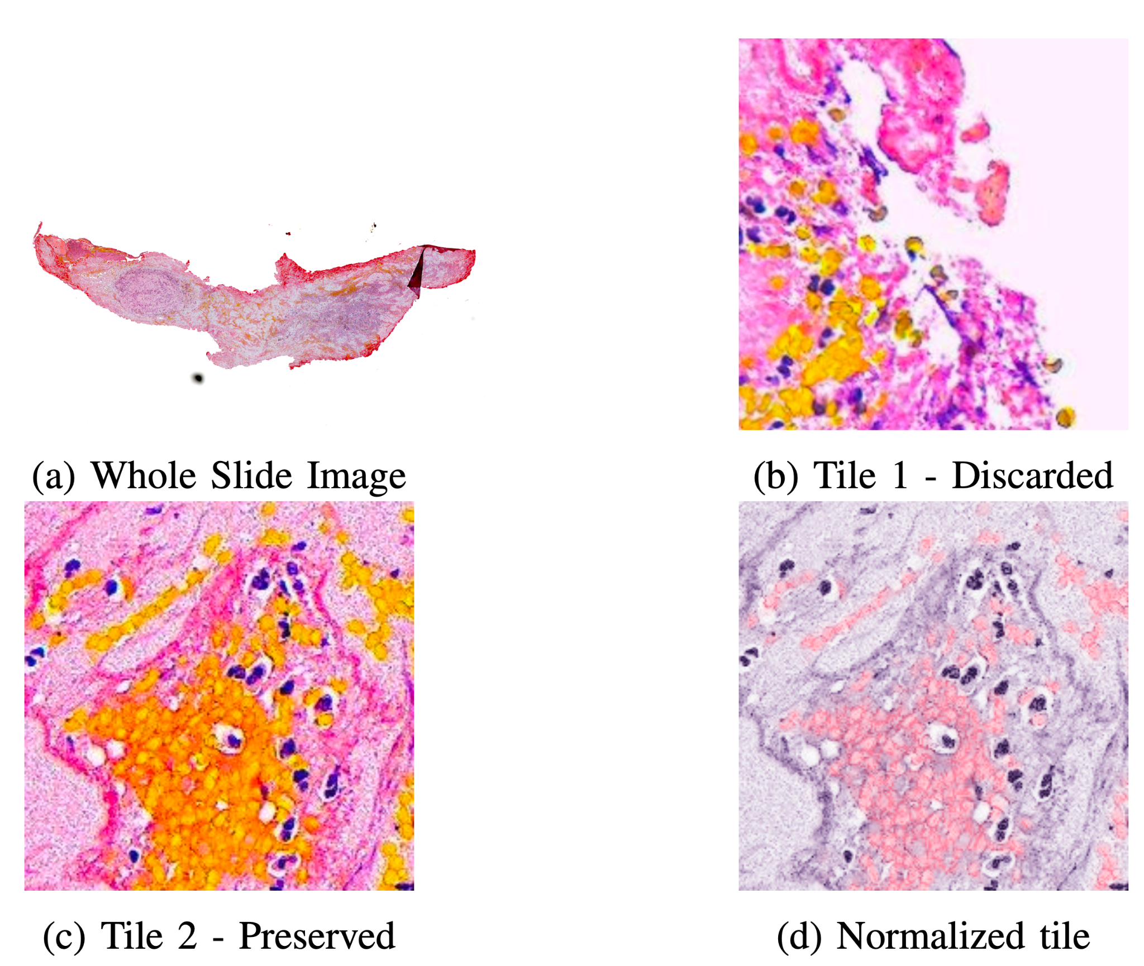

Slide 9
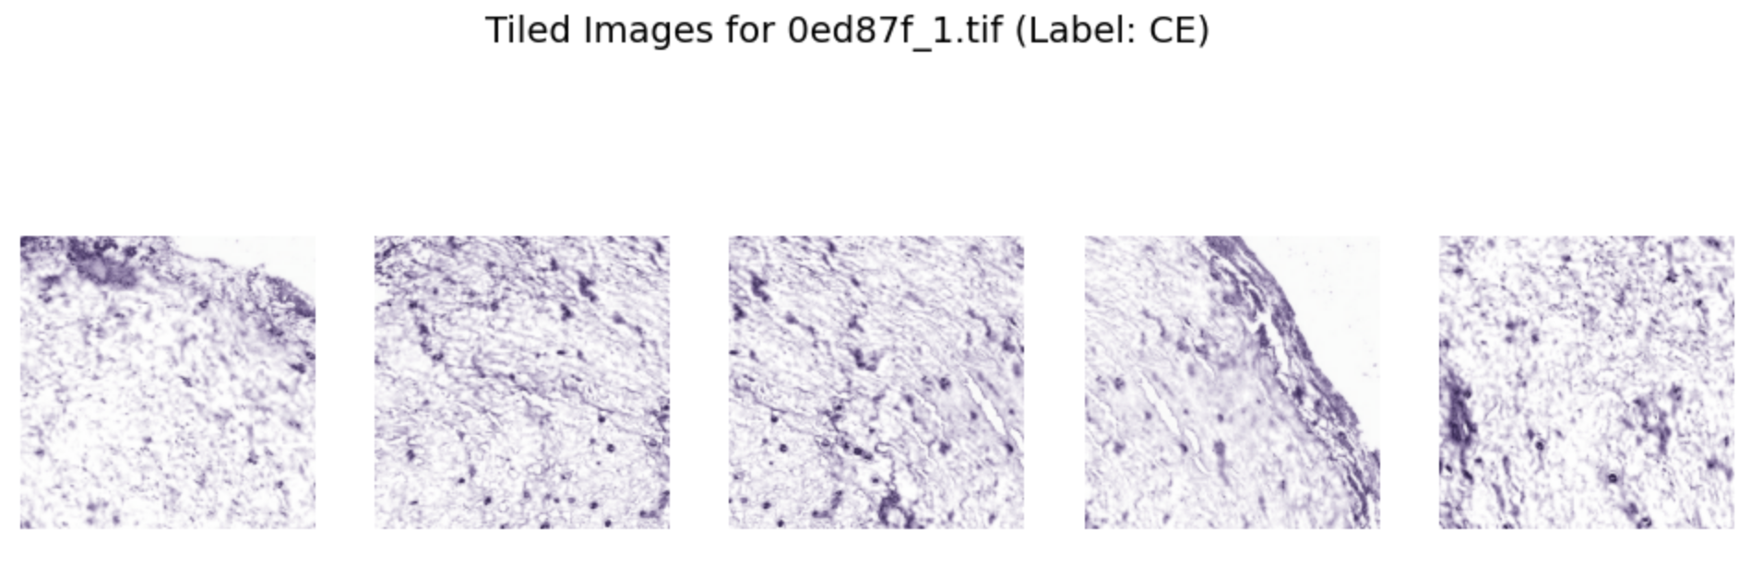
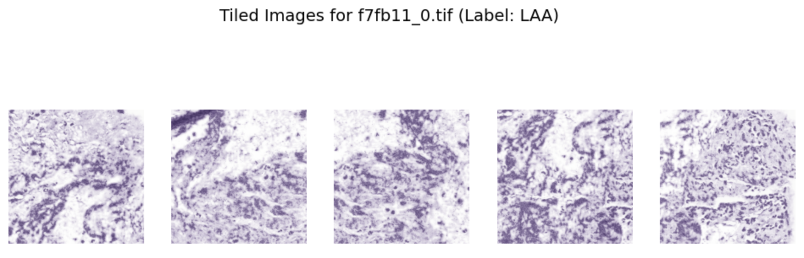
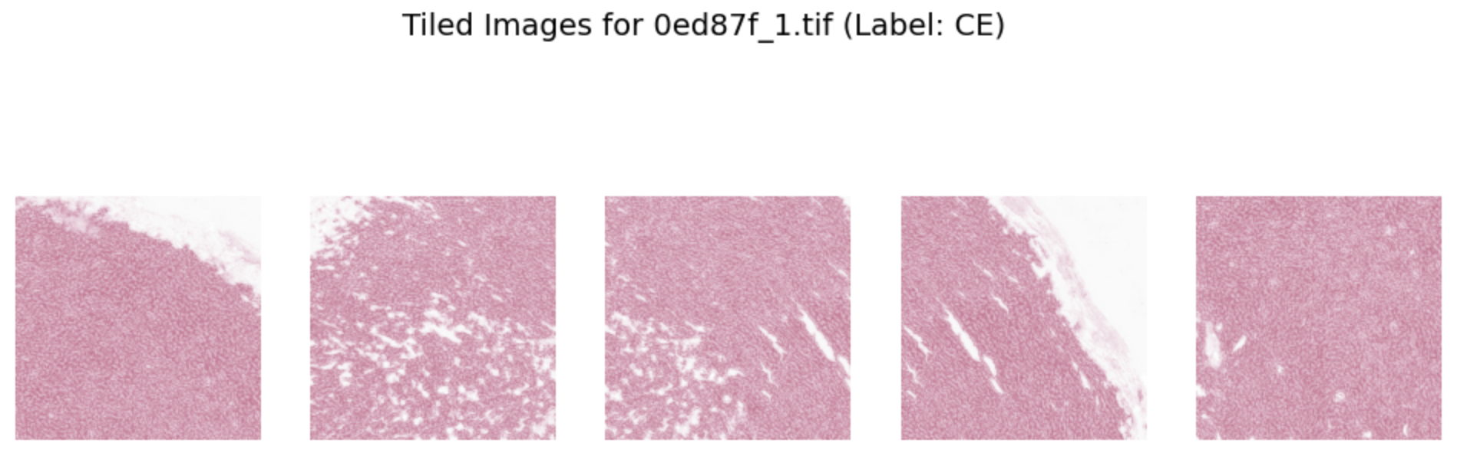
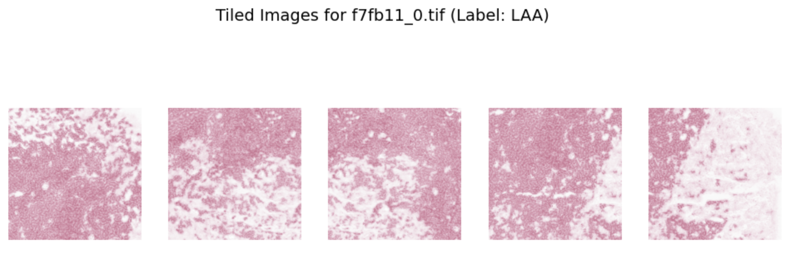
Features to extract
Feature | Cardioembolic (CE) | Large Artery Atherosclerosis (LAA)
Texture | More fibrin, mesh-like structures. | Less fibrin compared to CE
Nuclei Density | Fewer scattered nuclei, loosely packed | More densely packed nuclei
Isolated Hematoxylin stain, Highlights cell nuclei :
Isolated Eosin stain, Highlights cytoplasm and fibrin:

Slide 10
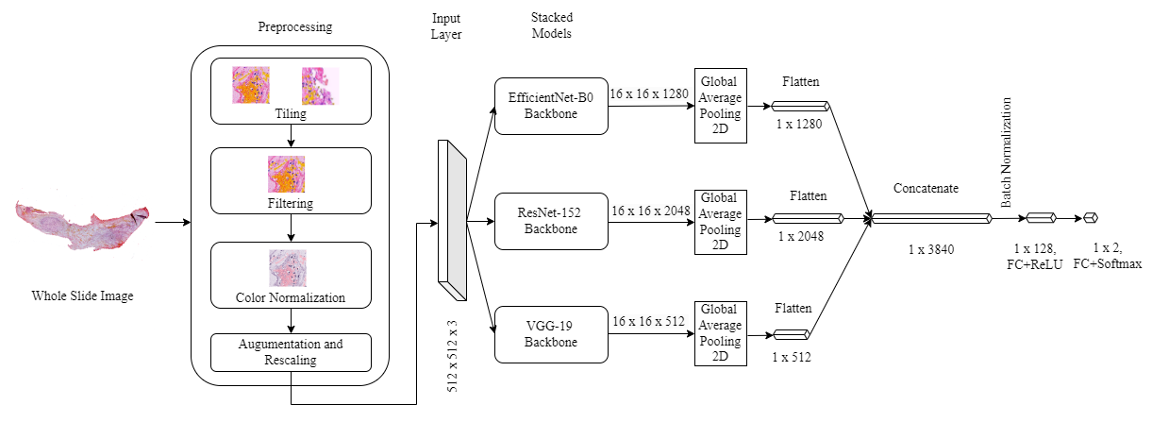
Model Architecture

Slide 11
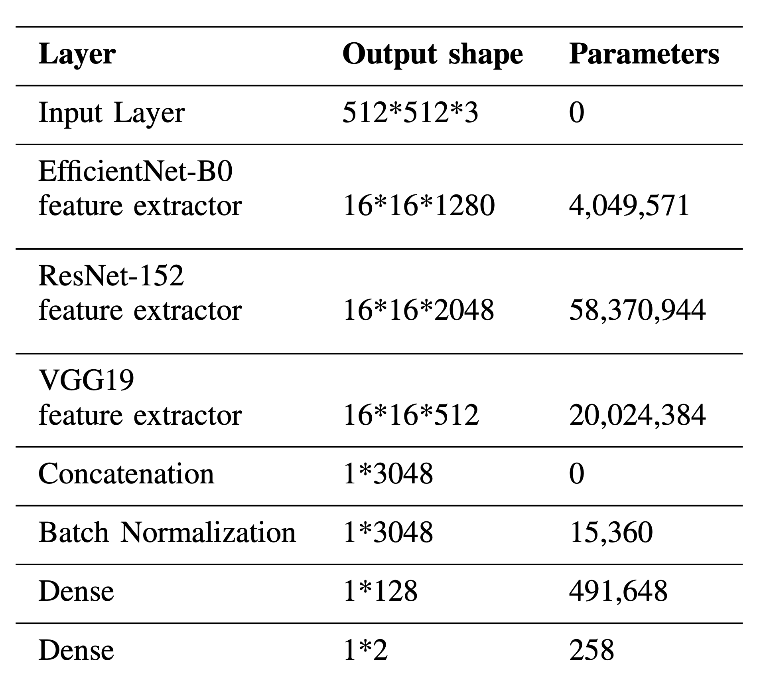
EfficientNet-B0, ResNet-152 and VGG-19 stacked model

Slide 12
Results

Slide 13
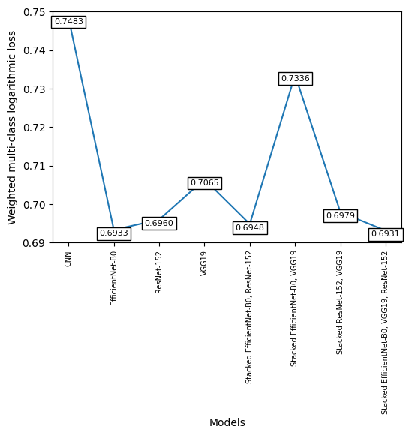

Slide 14
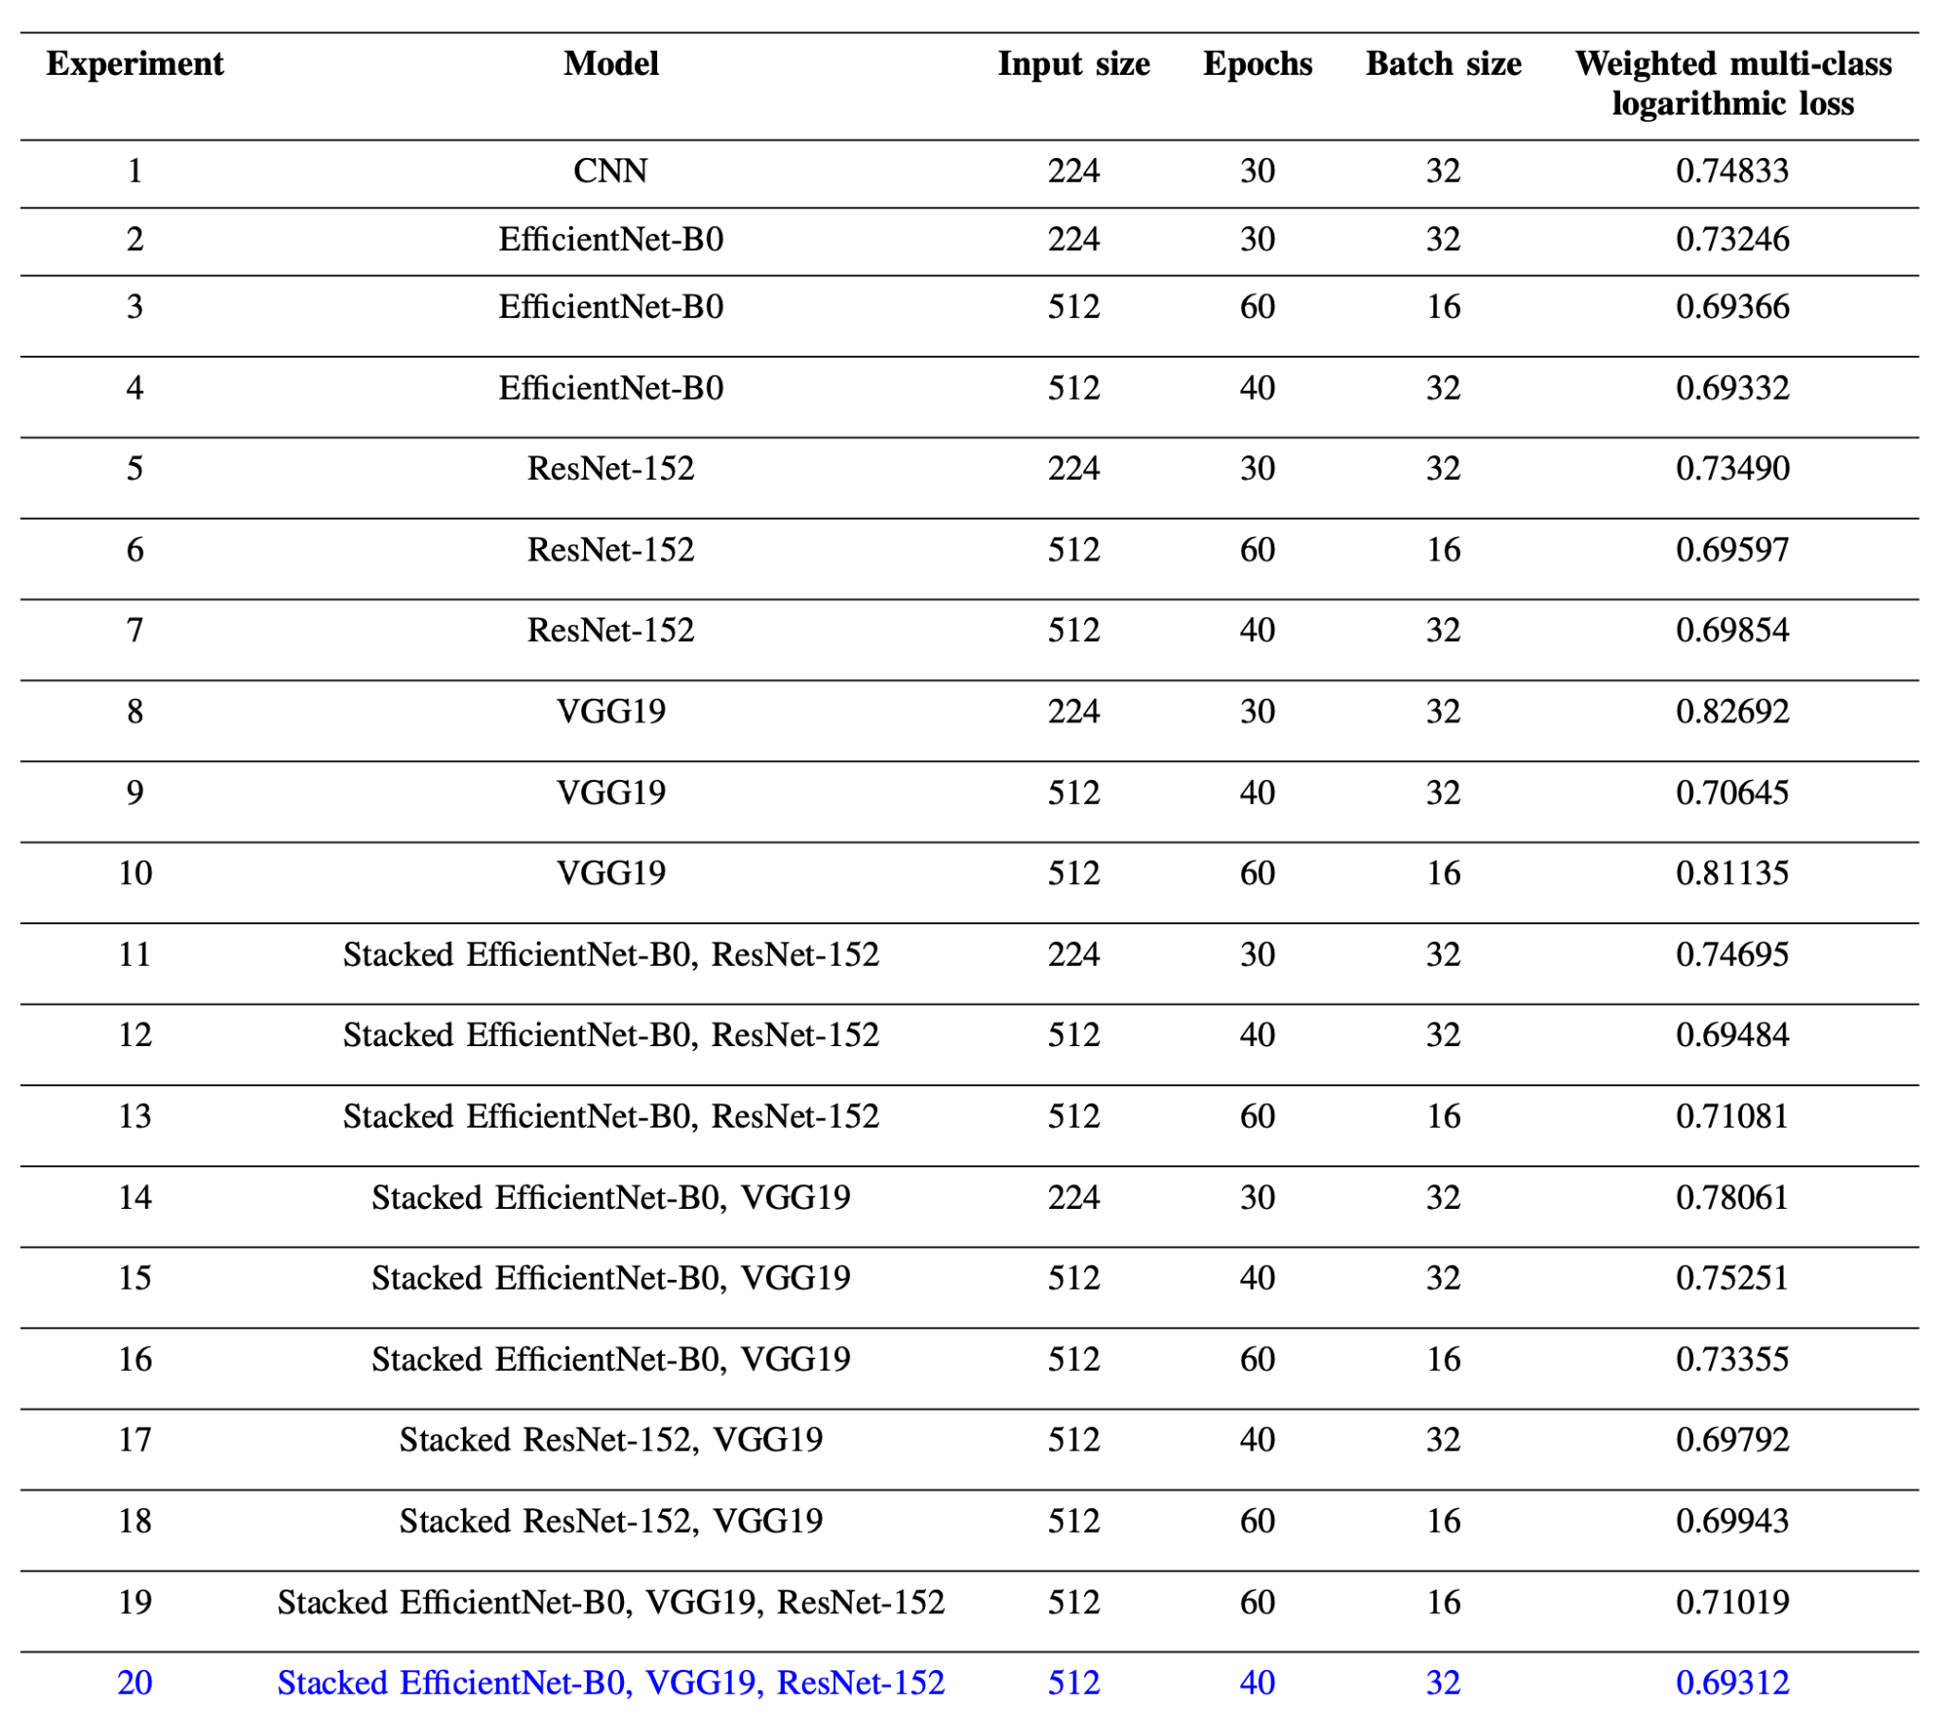
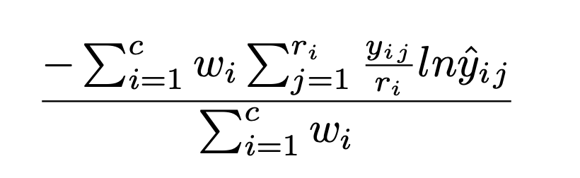

Slide 15
Challenges
High-Resolution Whole Slide Images (WSIs) – Managing gigapixel-scale WSIs with complex formats and computational constraints.
Preprocessing Challenges – Effective background elimination, artifact removal, and tile selection to enhance data quality.
Class Imbalance – Addressing skewed distributions in pathology datasets for robust model generalization.
Limited Annotated Pathology Slides – Scarcity of expert-labeled data affecting supervised learning approaches.
Feature Representation – Extracting and distinguishing histopathological patterns relevant to classification.
Model Development & Selection – Choosing optimal deep learning architectures tailored for histopathology analysis.
Hyperparameter Optimization – Fine-tuning deep models for optimal performance while mitigating overfitting.

Slide 16
Conclusion
The proposed stacked model of EfficientNet-B0, ResNet-152 and VGG19 performs the task of classifying the brain stroke etiology subtypes i.e., Cardioembolism and Large artery atherosclerosis.
This allows us to do away with the requirement for human aid and the uncertainties associated with it.
With this work, healthcare providers will have the ability to more accurately determine the source of blood clots that cause fatal strokes, allowing physicians to provide more effective post-stroke treatment and decreasing the chance of a recurrent stroke.
As a future work, the usage of models that are pre-trained on digital pathology whole slide images needs to be explored as it improves the performance.

Slide 17
ThankYou.

